Slide 1
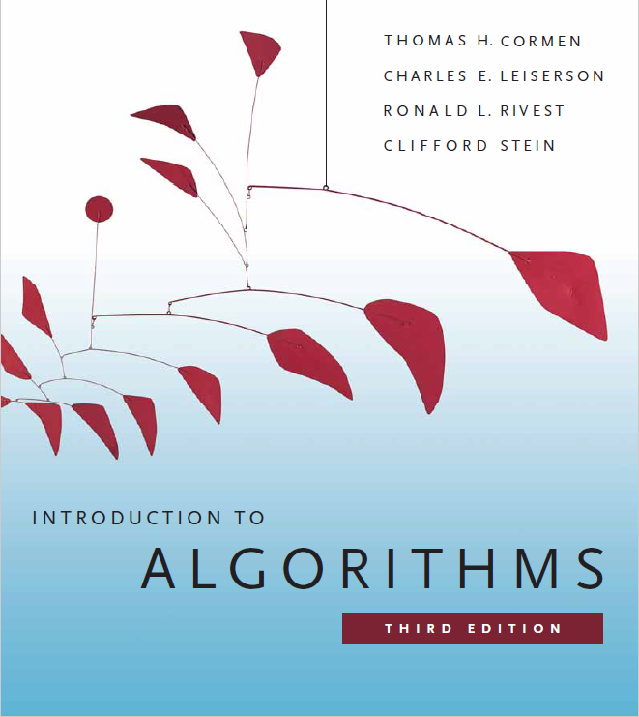
Greedy Algorithms
Prepared by Shmuel Wimer
Instructed by Deganit Armon and Shmuel Wimer

Slide 2
Overview
Dynamic programming (DP) finds optimal solution with memoization and back traversal.
Only at termination the entire solution is disclosed.
Greedy algorithms take at each step the best decision with no later regrets, simpler DP.
Greedy paradigm may result in non-optimal solution.
For some problems greedy algorithm yields optimal solution though.

Slide 3
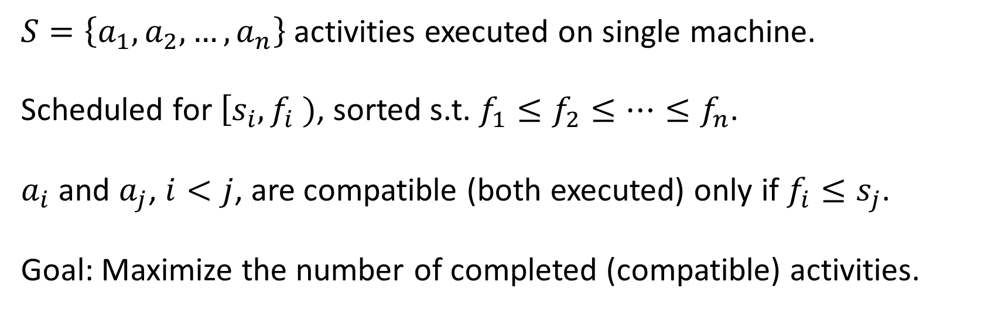
Activity Selection Problem
$S=\left\{a_{1}, a_{2},…,a_{n}\right\}$ activities executed on single machine.
Scheduled for $\left[s_{i},f_{i} \right.)$, sorted s.t. $f_{1}≤f_{2}≤⋯≤f_{n}$.
$a_{i}$ and $a_{j}$, $i<j$, are compatible (both executed) only if $f_{i}≤s_{j}$.
Goal: Maximize the number of completed (compatible) activities.

Slide 4












$$a_{11}$$
$$a_{10}$$
$$a_{9}$$
$$a_{8}$$
$$a_{7}$$
$$a_{6}$$
$$a_{5}$$
$$a_{4}$$
$$a_{3}$$
$$a_{2}$$
$$a_{1}$$
$$t$$

Slide 5
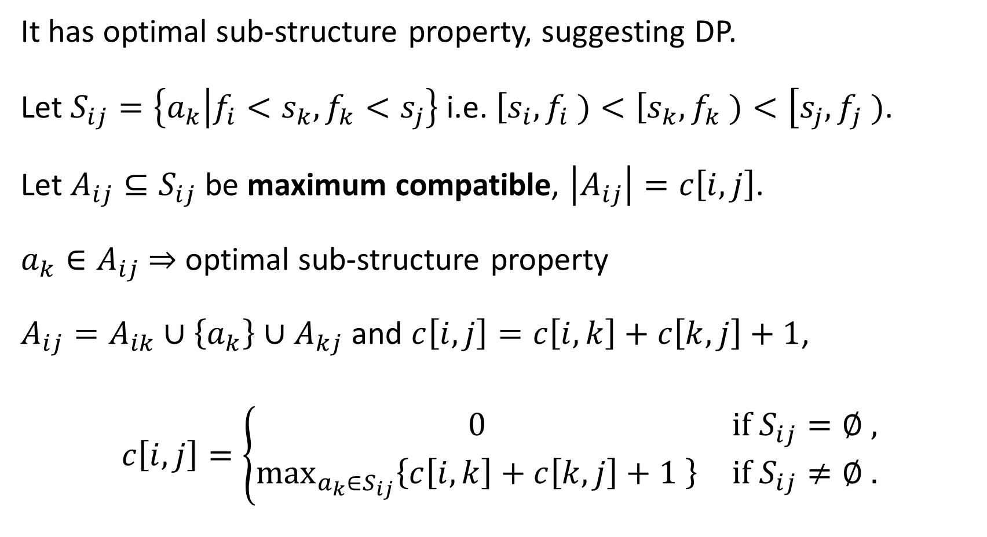
It has optimal sub-structure property, suggesting DP.
Let $S_{ij}=\left\{a_{k} | f_{i}<s_{k},f_{k}<s_{j}\right\}$ i.e. $\left[s_{i},f_{i} \right.)<\left[s_{k},f_{k} \right.)<\left[s_{j},f_{j} \right.)$.
Let $A_{ij}⊆S_{ij}$ be maximum compatible, $\left|A_{ij}\right|=c\left[i,j\right]$.
$a_{k}∈A_{ij}$ ⇒ optimal sub-structure property
$A_{ij}=A_{ik}∪\left\{a_{k}\right\}∪A_{kj}$ and $c\left[i,j\right]=c\left[i,k\right]+c\left[k,j\right]+1$,
$$c\left[i,j\right]=\left\{\begin{matrix}0 & \text{if} S_{ij}=∅ , \\ \max_{a_{k}∈S_{ij}}\left\{c\left[i,k\right]+c\left[k,j\right]+1 \right\} & \text{if} S_{ij}≠∅ .\end{matrix}\right.$$

Slide 6
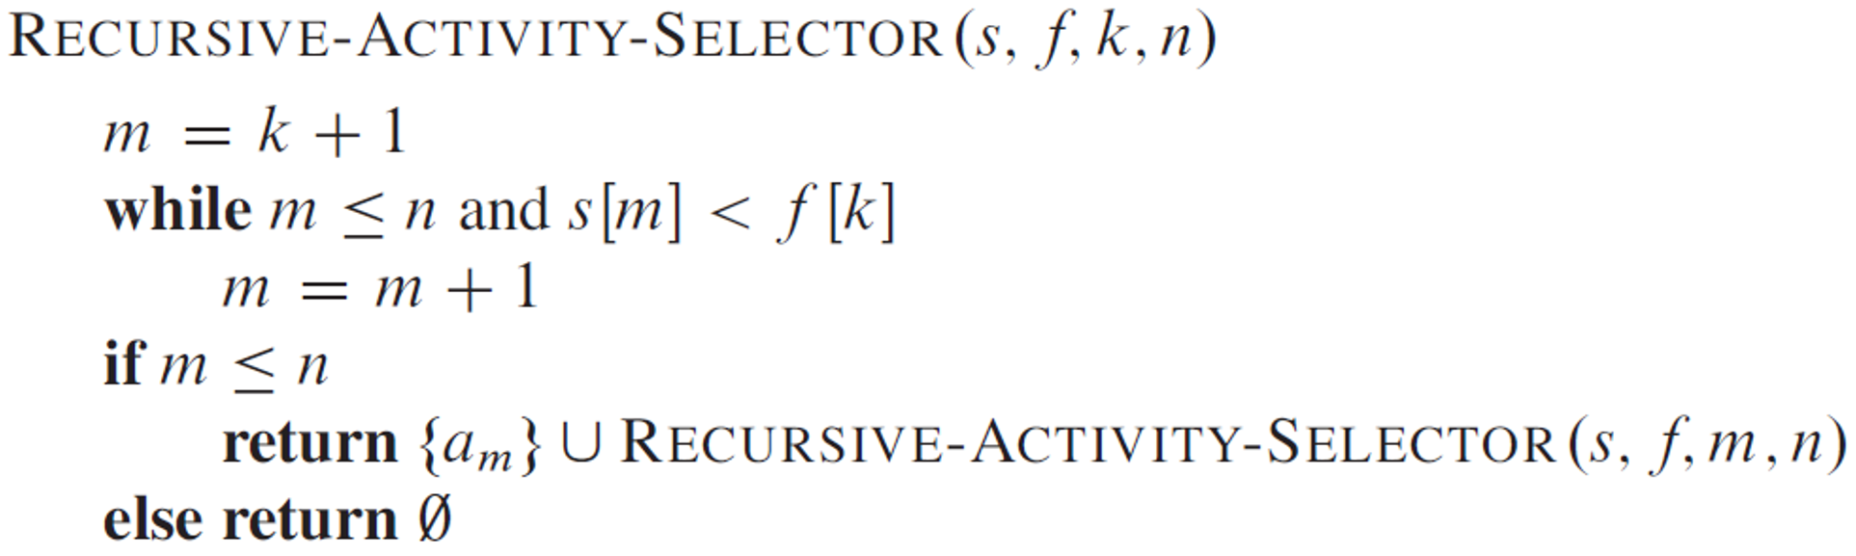
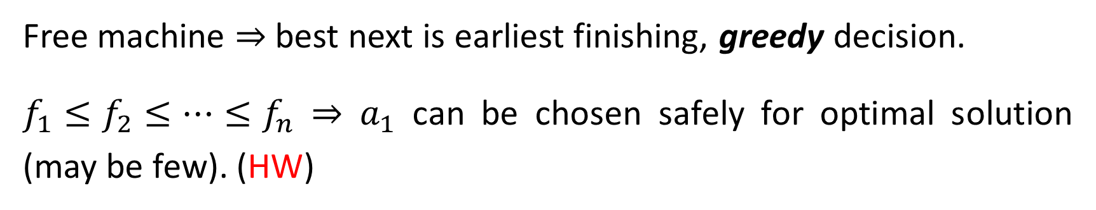
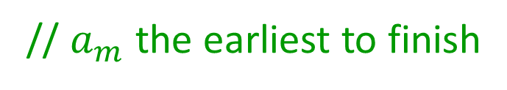
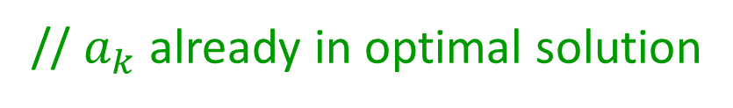
Free machine ⇒ best next is earliest finishing, greedy decision.
$f_{1}≤f_{2}≤⋯≤f_{n}$ ⇒ $a_{1}$ can be chosen safely for optimal solution (may be few). (HW)
// $a_{k}$ already in optimal solution
// skip overlapping activities
// $a_{m}$ the earliest to finish

Slide 7
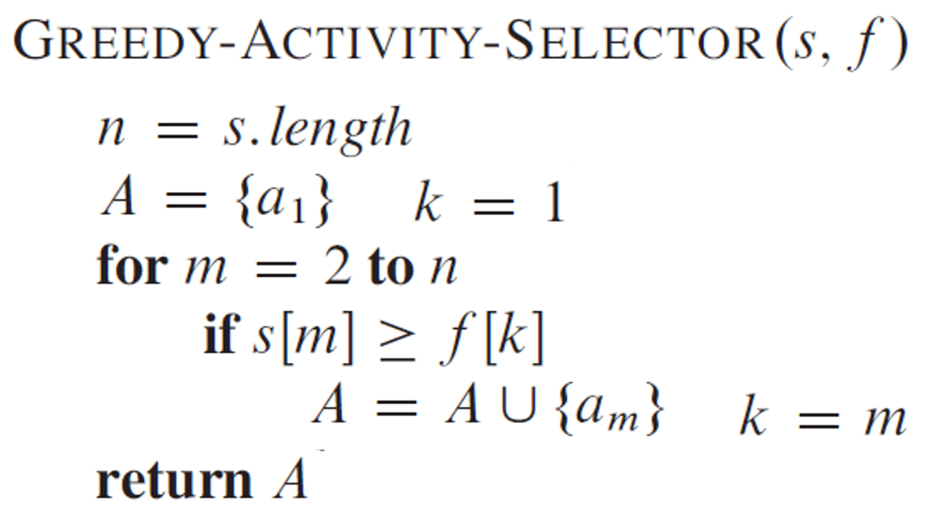
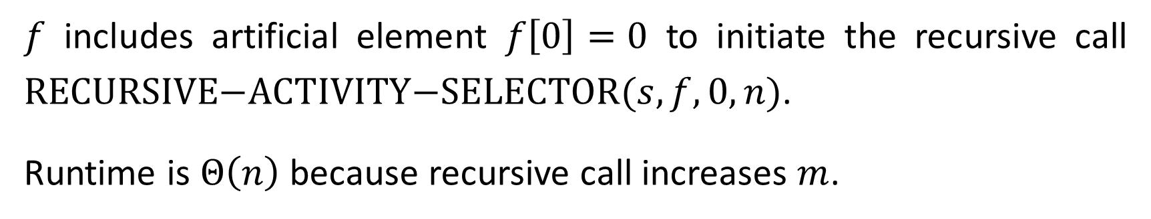
$f$ includes artificial element $f\left[0\right]=0$ to initiate the recursive call $\text{RECURSIVE}\text{−}\text{ACTIVITY}\text{−}\text{SELECTOR}(s,f,0,n)$.
Runtime is $Θ\left(n\right)$ because recursive call increases $m$.
;
;
$Θ\left(n\right)$ runtime but runs more efficiently on hardware.

Slide 8
Elements of Greedy Strategy
Greedy-choice property makes currently best choice without considering sub-problems results, leaving only one sub-problem.
Must prove that greedy choice yields a globally optimal solution. (Unlike DP where choice at each step depends on sub-problems solutions.)
Like DP, problem exhibits optimal sub-structure if its optimal solution contains optimal solutions to sub-problems.

Slide 9
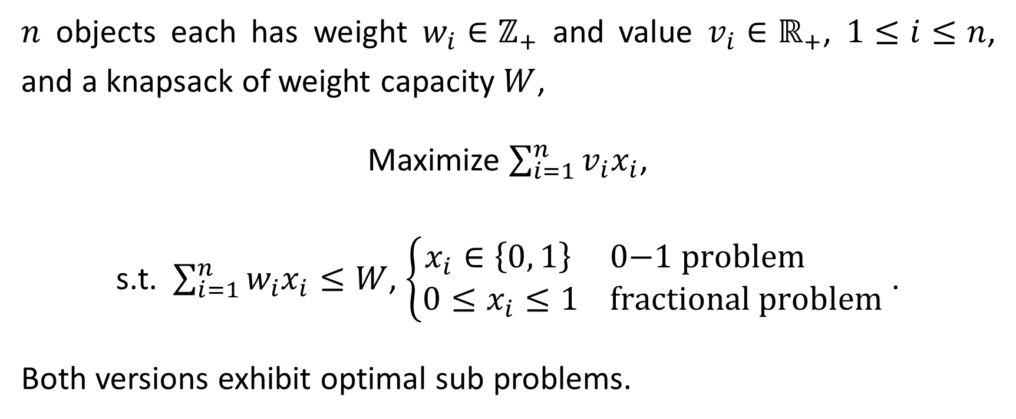
The Knapsack Problem
$n$ objects each has weight $w_{i}∈ℤ_{+}$ and value $v_{i}∈ℝ_{+}$, $1≤i≤n$, and a knapsack of weight capacity $W$,
Maximize $\sum_{i=1}^{n}{v_{i}x_{i}}$,
s.t. $\sum_{i=1}^{n}{w_{i}x_{i}}≤W$, $\left\{\begin{aligned}x_{i}∈\left\{0, 1\right\} \text{0−1 }\text{problem} \\ {0≤x}_{i}≤1 \text{fractional} \text{problem}\end{aligned}\right.$ .
Both versions exhibit optimal sub problems.

Slide 10
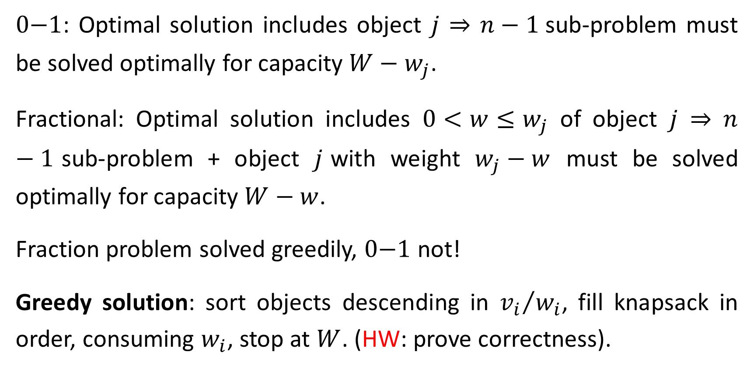
$\text{0−1}$: Optimal solution includes object $j$ ⇒ $n−1$sub-problem must be solved optimally for capacity $W−w_{j}$.
Fractional: Optimal solution includes $0<w≤w_{j}$ of object $j$ ⇒ $n−1$sub-problem + object $j$with weight $w_{j}−w$ must be solved optimally for capacity $W−w$.
Fraction problem solved greedily, $\text{0−1}$ not!
Greedy solution: sort objects descending in ${v_{i}}/{w_{i}}$, fill knapsack in order, consuming $w_{i}$, stop at $W$. (HW: prove correctness).

Slide 11
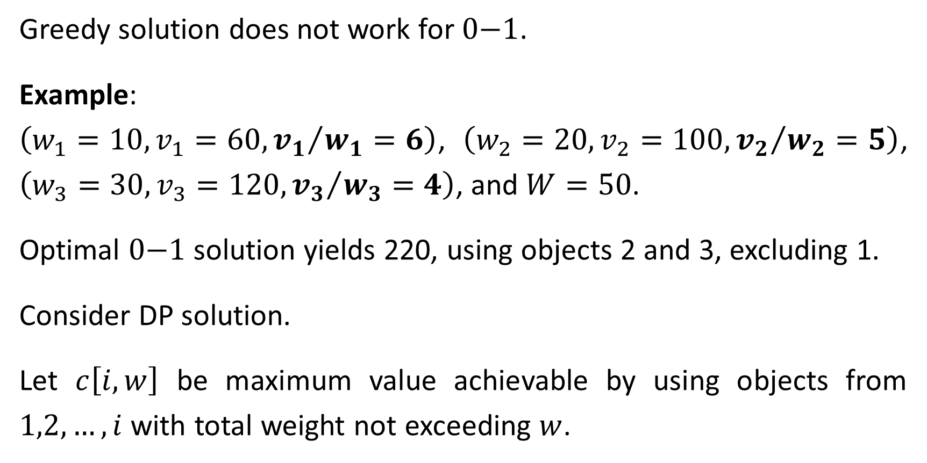
Greedy solution does not work for $\text{0−1}$.
Example:
$\left(w_{1}=10,v_{1}=60, {v_{1}}/{w_{1}}=6\right)$, $\left(w_{2}=20,v_{2}=100, {v_{2}}/{w_{2}}=5\right)$, $\left(w_{3}=30,v_{3}=120, {v_{3}}/{w_{3}}=4\right)$, and $W=50$.
Optimal $\text{0−1}$ solution yields 220, using objects 2 and 3, excluding 1.
Consider DP solution.
Let $c\left[i,w\right]$ be maximum value achievable by using objects from $1,2,…,i$ with total weight not exceeding $w$.

Slide 12
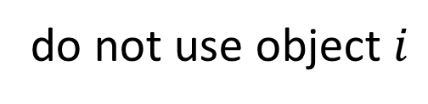
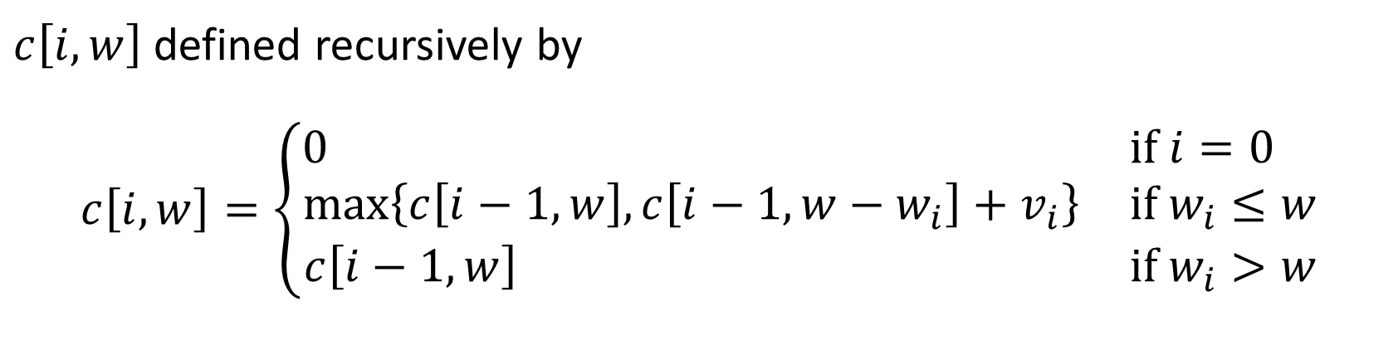
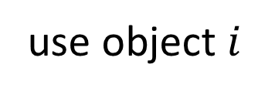
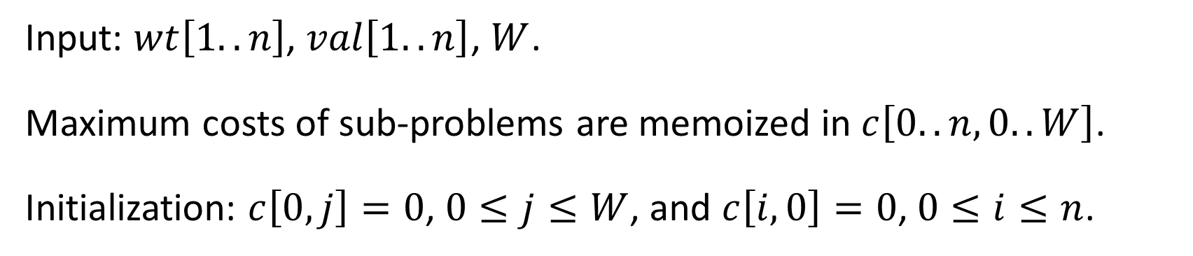
$c\left[i,w\right]$ defined recursively by
$$c\left[i,w\right]=\left\{\begin{matrix}0 & \text{if} i=0 \\ \text{max}\left\{c\left[i−1,w\right],c\left[i−1,w−w_{i}\right]+v_{i}\right\} & \text{if}{ w}_{i}≤w \\ c\left[i−1,w\right] & \text{if} w_{i}>w\end{matrix}\right.$$
do not use object $i$
use object $i$
Input: $wt\left[1..n\right]$, $val\left[1..n\right]$, $W$.
Maximum costs of sub-problems are memoized in $c\left[0..n,0..W\right]$.
Initialization: $c\left[0,j\right]=0$, $0≤j≤W$, and $c\left[i,0\right]=0$, $0≤i≤n$.

Slide 13
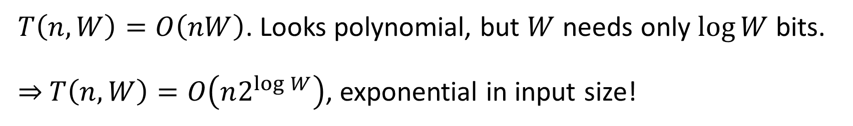
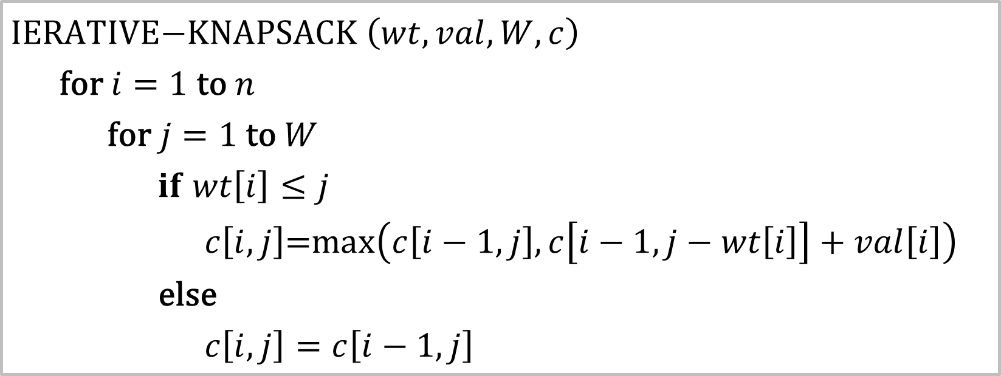
$\text{IERATIVE}\text{−}\text{KNAPSACK}$ $\left(wt,val,W,c\right)$
$\text{for} i=1 \text{to} n$
$\text{for} j=1 \text{to} W$
$if$ $wt\left[i\right]≤j$
$c\left[i,j\right]\text{=}\text{max}\left(c\left[i−1,j\right],c\left[i−1,j−wt\left[i\right]\right]+val\left[i\right]\right)$ $\text{else}$
$c\left[i,j\right]=c\left[i−1,j\right]$
$T\left(n,W\right)=O\left(nW\right)$. Looks polynomial, but $W$ needs only $\log{W}$ bits.
⇒ $T\left(n,W\right)=O\left(n2^{\log{W}}\right)$, exponential in input size!

Slide 14
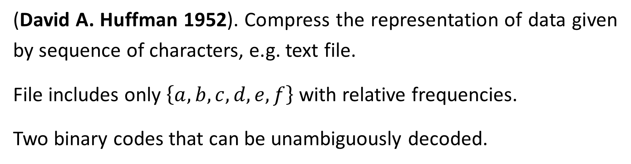
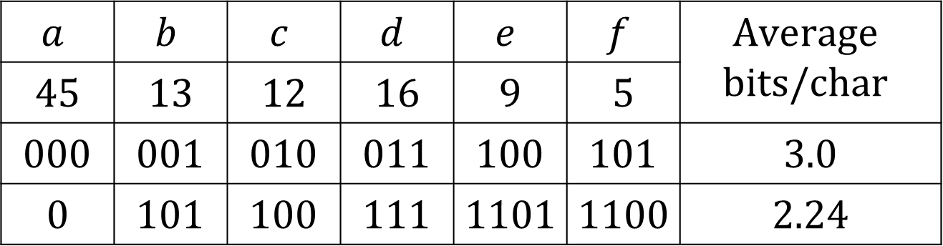
Huffman Codes
(David A. Huffman 1952). Compress the representation of data given by sequence of characters, e.g. text file.
File includes only $\left\{a,b,c,d,e,f\right\}$ with relative frequencies.
Two binary codes that can be unambiguously decoded.
minimize
$$a$$ | $$b$$ | $$c$$ | $$d$$ | $$e$$ | $$f$$ | $$\text{Average}$$ $$\text{bits}\text{/}\text{char}$$
$$45$$ | $$13$$ | $$12$$ | $$16$$ | $$9$$ | $$5$$
$$000$$ | $$001$$ | $$010$$ | $$011$$ | $$100$$ | $$101$$ | $$3.0$$
$$0$$ | $$101$$ | $$100$$ | $$111$$ | $$1101$$ | $$1100$$ | $$2.24$$
Frequency [%]
Fixed-length
Variable-length

Slide 15
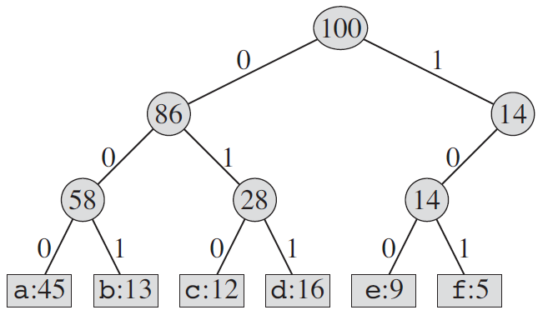
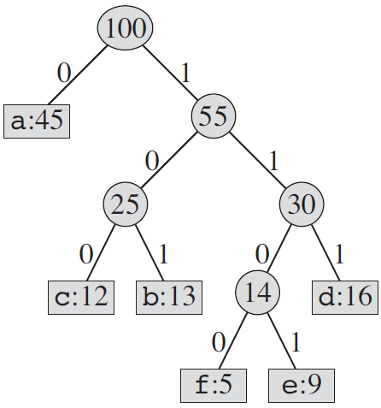












Fixed-length
Variable-length
$$0$$
$$000$$
$$001$$
$$010$$
$$011$$
$$100$$
$$101$$
$$100$$
$$101$$
$$111$$
$$1100$$
$$1101$$

Slide 16
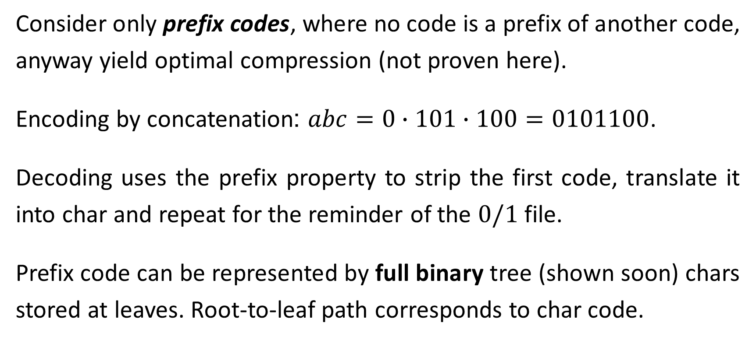
Consider only prefix codes, where no code is a prefix of another code, anyway yield optimal compression (not proven here).
Encoding by concatenation: $abc=0∙101∙100=0101100$.
Decoding uses the prefix property to strip the first code, translate it into char and repeat for the reminder of the $0/1$ file.
Prefix code can be represented by full binary tree (shown soon) chars stored at leaves. Root-to-leaf path corresponds to char code.

Slide 17




$$0$$
$$100$$
$$101$$
$$111$$
$$1100$$
$$1101$$
$$01011100=?=$$
$$a$$
$$b$$
$$f$$

Slide 18
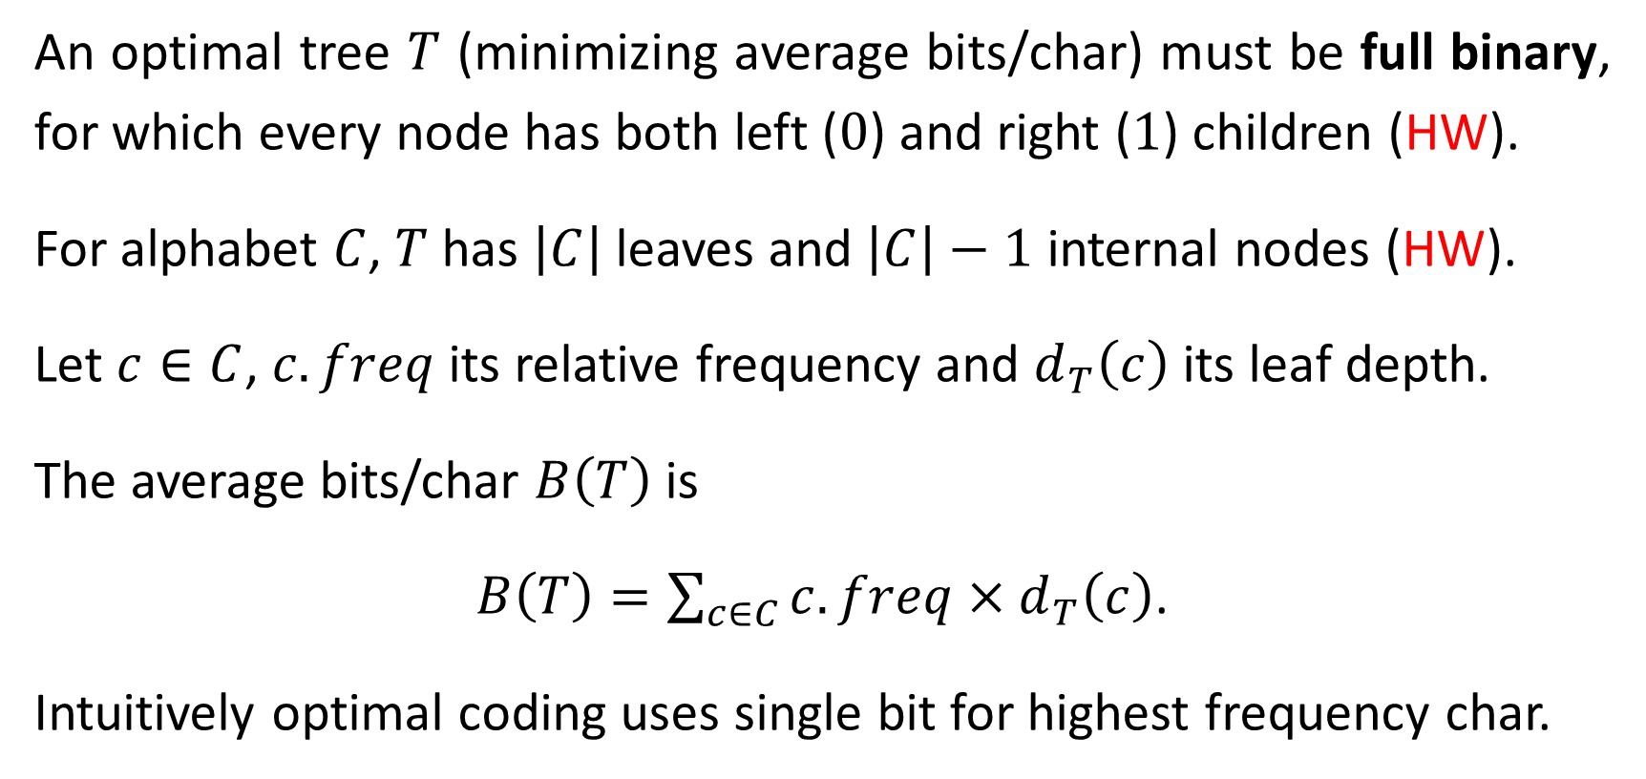
An optimal tree $T$ (minimizing average bits/char) must be full binary, for which every node has both left ($0$) and right ($1$) children (HW).
For alphabet $C$, $T$has $\left|C\right|$ leaves and $\left|C\right|−1$ internal nodes (HW).
Let $c∈C$, $c.freq$ its relative frequency and $d_{T}\left(c\right)$ its leaf depth.
The average bits/char $B\left(T\right)$ is
$B\left(T\right)=\sum_{c∈C}{c.freq×d_{T}\left(c\right)}$.
Intuitively optimal coding uses single bit for highest frequency char.

Slide 19

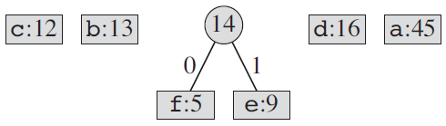
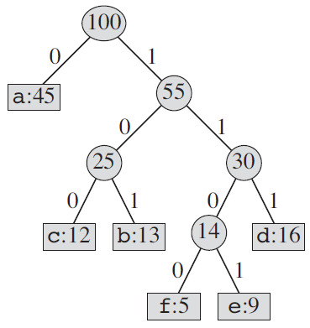
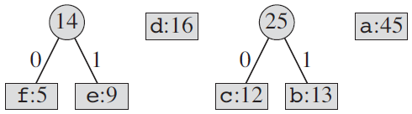
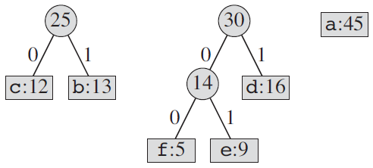








$$\text{EXTRACT}\text{−}\text{MIN}$$
$$\text{EXTRACT}\text{−}\text{MIN}$$
$$\text{INSERT}$$
$$\text{EXTRACT}\text{−}\text{MIN}$$
$$\text{INSERT}$$
$$\text{EXTRACT}\text{−}\text{MIN}$$
$$\text{INSERT}$$
$$\text{EXTRACT}\text{−}\text{MIN}$$

Slide 20
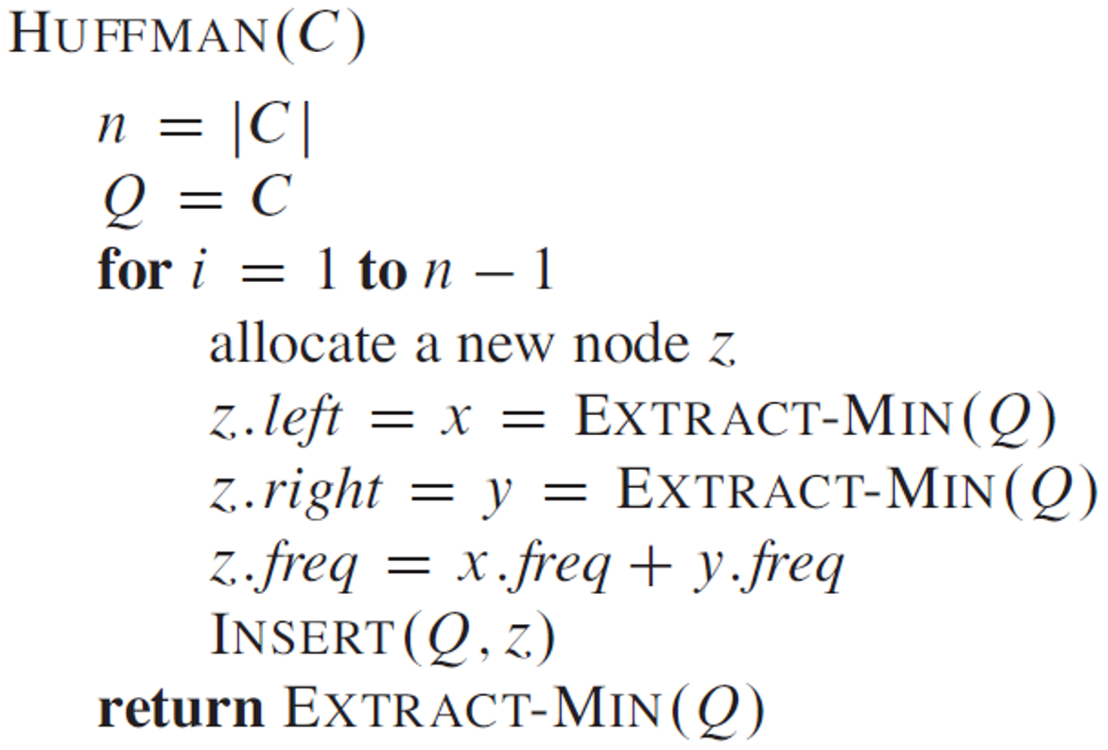
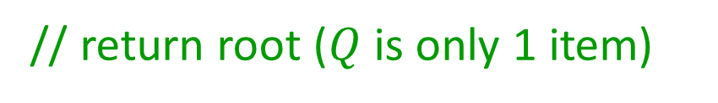
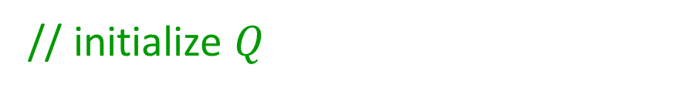
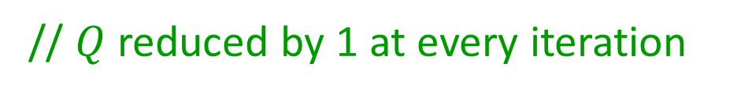
Algorithm stores $C$ in min-queue (heap) $Q$ keyed on frequencies.
// initialize $Q$
// $Q$reduced by 1 at every iteration
// get min frequency
// get min frequency
// insert node and maintain min-priority
// return root ($Q$ is only 1 item)

Slide 21
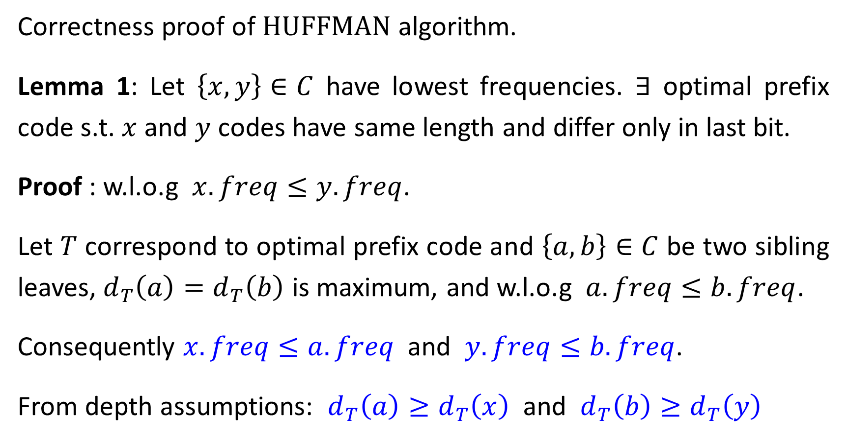
Correctness proof of $\text{HUFFMAN}$ algorithm.
Lemma 1: Let $\left\{x,y\right\}∈C$ have lowest frequencies. $∃$ optimal prefix code s.t. $x$ and $y$ codes have same length and differ only in last bit.
Proof : w.l.o.g $x.freq≤y.freq$.
Let $T$ correspond to optimal prefix code and $\left\{a,b\right\}∈C$ be two sibling leaves, $d_{T}\left(a\right)=d_{T}\left(b\right)$ is maximum, and w.l.o.g $a.freq≤b.freq$.
Consequently $x.freq≤a.freq$ and $y.freq≤b.freq$.
From depth assumptions: $d_{T}\left(a\right)≥d_{T}\left(x\right)$ and $d_{T}\left(b\right)≥d_{T}\left(y\right)$

Slide 22
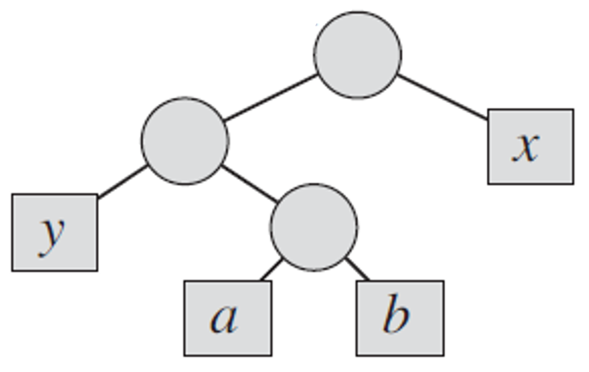
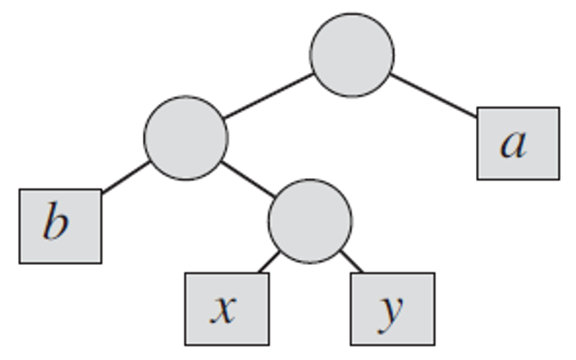

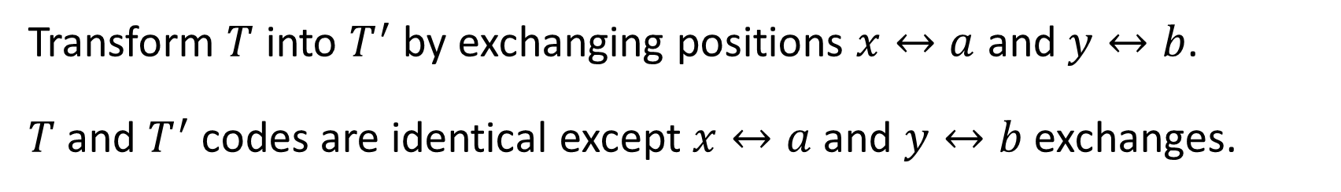

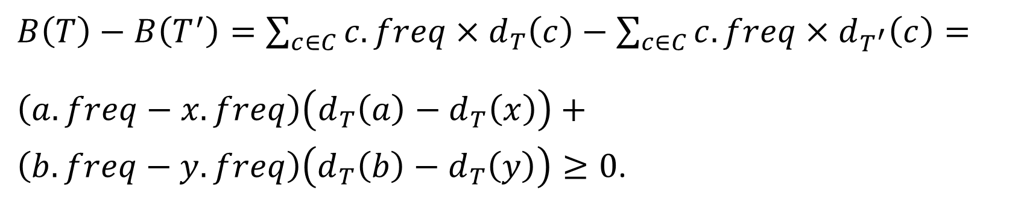
$$T$$
$$T^{′}$$
Transform $T$ into $T^{′}$ by exchanging positions $x↔a$ and $y↔b$.
$T$ and $T^{′}$ codes are identical except $x↔a$ and $y↔b$ exchanges.
$B\left(T\right)−B\left(T^{′}\right)=\sum_{c∈C}{c.freq×d_{T}\left(c\right)}−\sum_{c∈C}{c.freq×d_{T^{′}}\left(c\right)}=$
$\left(a.freq−x.freq\right)\left(d_{T}\left(a\right)−d_{T}\left(x\right)\right)+$
$\left(b.freq−y.freq\right)\left(d_{T}\left(b\right)−d_{T}\left(y\right)\right)≥0$.

Slide 23
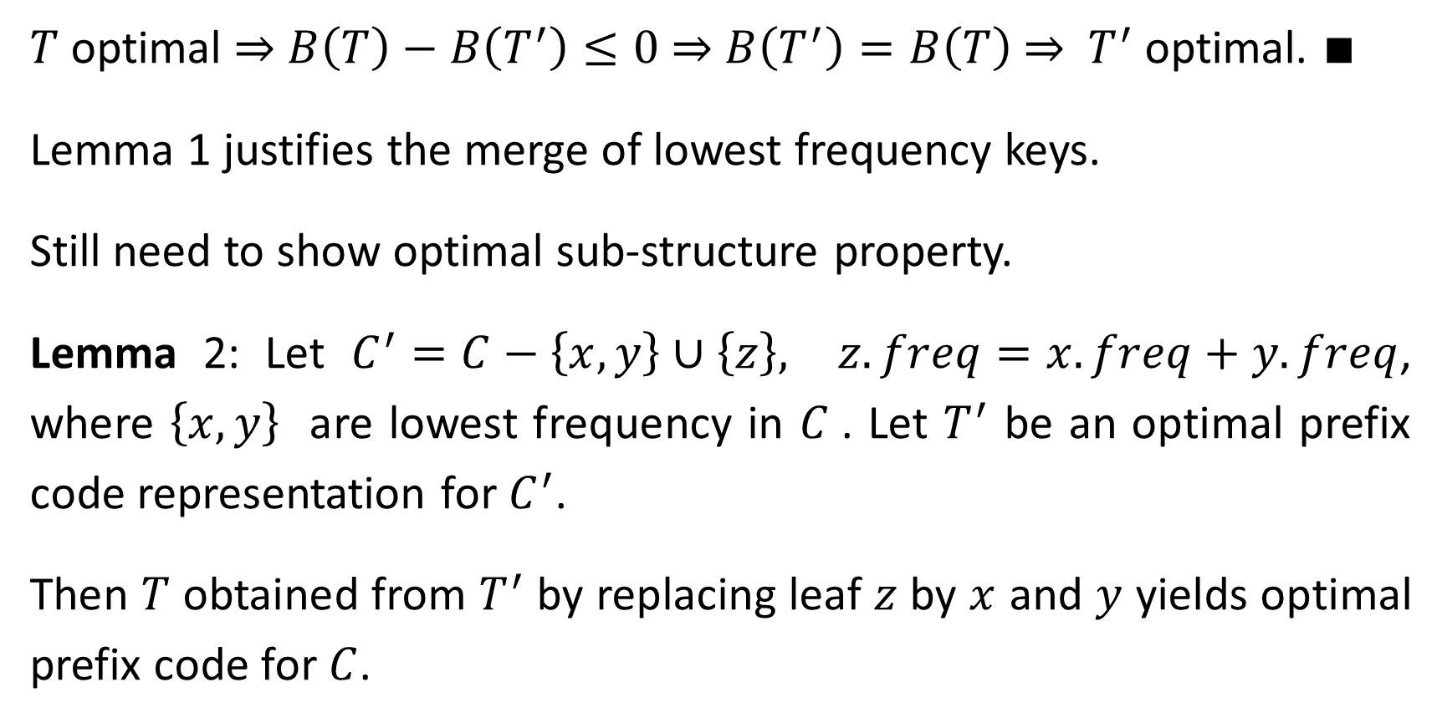
$T$ optimal ⇒ $B\left(T\right)−B\left(T^{′}\right)≤0$ ⇒ $B\left(T^{′}\right)=B\left(T\right)$ ⇒ $T^{′}$ optimal. $∎$
Lemma 1 justifies the merge of lowest frequency keys.
Still need to show optimal sub-structure property.
Lemma 2: Let $C^{′}=C−\left\{x,y\right\}∪\left\{z\right\},$ $z.freq=x.freq+y.freq$, where $\left\{x,y\right\}$ are lowest frequency in $C$. Let $T^{′}$ be an optimal prefix code representation for $C^{′}$.
Then $T$ obtained from $T^{′}$ by replacing leaf $z$ by $x$ and $y$ yields optimal prefix code for $C$.

Slide 24
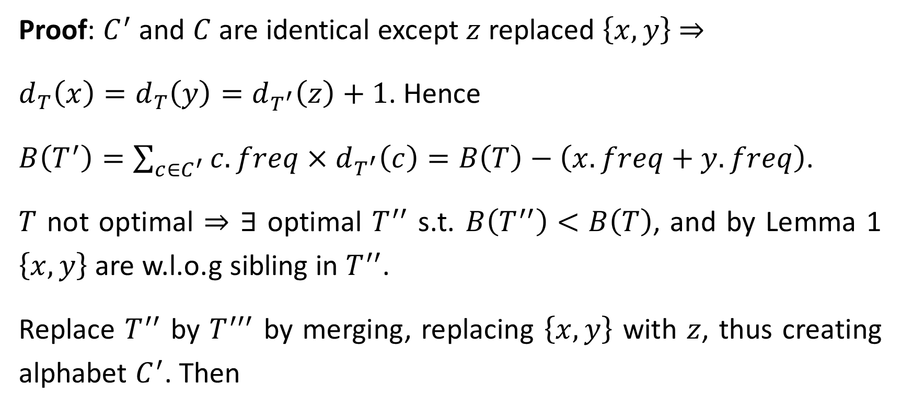
Proof: $C^{′}$ and $C$ are identical except $z$ replaced $\left\{x,y\right\}$ ⇒
$d_{T}\left(x\right)=d_{T}\left(y\right)=d_{T^{′}}\left(z\right)+1$. Hence
$B\left(T^{′}\right)=\sum_{c∈C^{′}}{c.freq×d_{T^{′}}\left(c\right)}=B\left(T\right)−\left(x.freq+y.freq\right)$.
$T$ not optimal ⇒ $∃$ optimal $T^{′′}$ s.t. $B\left(T^{′′}\right)<B\left(T\right)$, and by Lemma 1 $\left\{x,y\right\}$ are w.l.o.g sibling in $T^{′′}$.
Replace $T^{′′}$ by $T^{′′′}$ by merging, replacing $\left\{x,y\right\}$ with $z$, thus creating alphabet $C^{′}$. Then

Slide 25
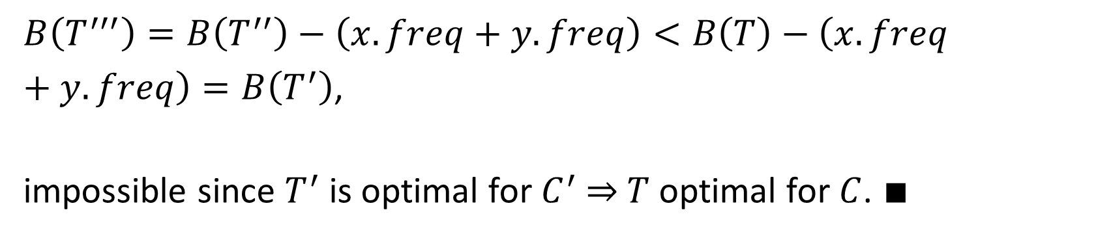
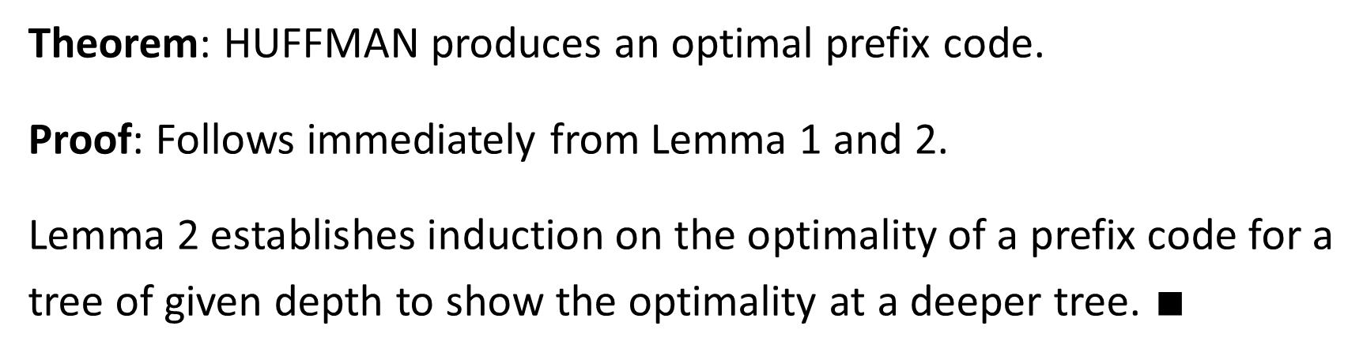

$B\left(T^{′′′}\right)=B\left(T^{′′}\right)−\left(x.freq+y.freq\right)<B\left(T\right)−\left(x.freq+y.freq\right)=B\left(T^{′}\right)$,
impossible since $T^{′}$ is optimal for $C^{′}$ ⇒ $T$ optimal for $C$. $∎$
$$d_{T^{′′}}\left(x\right)=d_{T^{′′}}\left(y\right)=d_{T^{′′′}}\left(z\right)+1$$
Theorem: HUFFMAN produces an optimal prefix code.
Proof: Follows immediately from Lemma 1 and 2.
Lemma 2 establishes induction on the optimality of a prefix code for a tree of given depth to show the optimality at a deeper tree. $∎$

